Slide 1


SIDDHARTH INSTITUTE OF ENGINEERING &TECHNOLOGY
(AUTONOMOUS)
(Approved by AICTE, New Delhi & Affiliated to JNTUA, Ananthapuramu)
(Accredited by NBA for Civil, EEE, Mech., ECE & CSEAccredited by NAAC with ‘A+’ Grade)
Puttur -517583, Tirupathi District, A.P. (India)
DEPARTMENT OF COMPUTER SCIENCE AND ENGINEERING
Title Of Project : Predicting Red Wine Quality Using Machine Learning Algorithms
Branch/Sec : Cse-3
Batch Details:
S.No | Roll No. | Name of the Students | Internal Guide
1 | 21F61A05E6 | K. Sujitha | Dr.A.SURESH Professor, Dept. of CSE
2 | 21F61A05G8 | Puttur Vanitha
3 | 21F61A05F6 | S. Tharun Kumar
4 | 21F61A05F2 | A.D. Tejasree

Slide 2
OBJECTIVE
The main objective of the project is to develop a machine learning-based system to accurately predict the quality of wine based on its physicochemical properties. (eg.,acidity,alcohol content,sugar levels)
Specific: Develop a machine learning model to predict red wine quality using chemical properties.
Measurable: Train machine learning models for accurate wine quality prediction.
Achievable: Use existing red wine datasets and apply standard machine learning techniques

Slide 3
ABSTRACT
Machine learning is one of the emerging areas of research. Many algorithms of data mining have already been used on wine quality dataset to analyze the wine attributes such as quality or class. The quality of wine is not only based on the quantity of alcohol but it also depends on various attributes, these attributes changes with time and so the quality of wine also refines. In this report, machine learning techniques are utilized to analyze those attributes. Firstly data pre-processing takes place i.e. making data appropriate for the models that are built for prediction. Defining independent and dependent variables, missing data handling, feature scaling and data splitting is done to improve the data standard. Then , XGBoost Algorithm ,Random Forest are performed individually on data to predict the test data values. XGBoost outperforms algorithm with accuracy 75-85% while RM has 70-80% accuracy rate.

Slide 4
LITERATURE SURVEY
S.No | Title of the Paper | Year of Publication | Author | Comments
1. | Wine Quality and Taste Classification Using Machine Learning | 2020 | Anurag Sinha, Atul Kumar | Boarder dataset Include diverse wine types to improve model robustness. Can also Apply complex ML algorithms and feature engineering.
2. | A Study and Analysis of Machine Learning Techniques in Predicting Wine Quality | 2021 | Mohit Gupta, Vanmathi C | Improve model robustness by filling data gaps. Expand datasets to refine model accuracy.
3. | Prediction Wine Quality Using Machine Learning Algorithms | 2021 | k.R.Dahal,J.N.Dahal,H.Banjade,S.Gaire | "Complexity of Wine Quality Determinants Model Generalization and External Validation To give Limited Dataset Size"
4. | A Machine learning application in wine quality prediction | 2022 | Piyush Bharadwaj, Parul Tiwari,Kenneth Oleja Jr,Wendy Parr,Don Kulasiri | Test across diverse wine types and conditions.Focus on external validation to improve adaptability.

Slide 5
INFERENCES FROM LITERATURE SURVEY
Dataset Diversity
Using a wider variety of wine data improves model accuracy and robustness.
Feature Engineering
Applying advanced machine learning techniques enhances prediction performance.
Model Challenges
Wine quality is influenced by many factors, making generalization difficult.
External Validation
Testing models on different datasets ensures better real-world accuracy

Slide 6
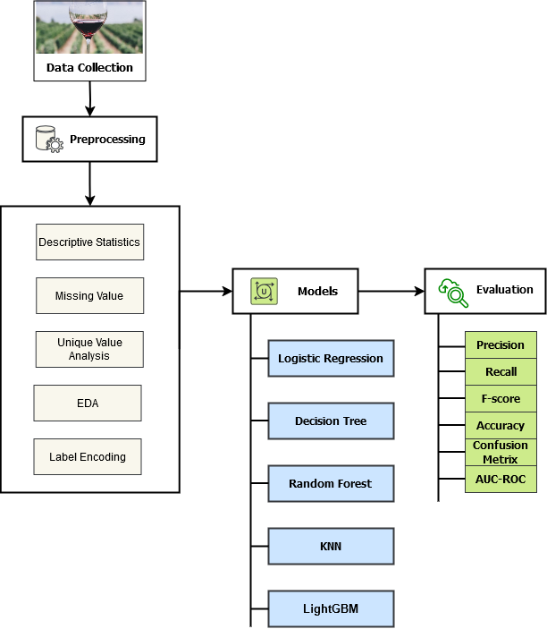
ARCHITECTURAL DIAGRAM

Slide 7
EXISTING SYSTEM
Data Driven Approach:
Machine learning models applied to predict wine quality.Uses the physicochemical properties .(acidity,alcohol,ph,etc.)
Algorithms Used In Existing System:
Logistic Regression
Random Forest
Random Forest achieved the highest accuracy
Feature selection improves model performance

Slide 8
Challenges Identified In Existing System:
Imbalanced dataset:
Most wines have average quality scores
Some models overdraft due to high dimentional data.
Lacks real time prediction capabilities for winemakers.
External factors are not considered.
e.g.,Grape variety,fermentation condition

Slide 9
PROPOSED METHODOLOGY
Dataset & Challenges:
Uses the wine quality dataset from the UCI ML Repository ,containing physicochemical features and sensory ratings.
Preprocessing & Data Analysis:
Includes descriptive statistic ,missing value analysis and visualizations.
Identifies key corelations(eg.,alcohol and acidity impact quality).
Applies label encoding and categories quality ratings into “Good ,Middle and Bad”
Classification Models & Evaluation:
Split the data into 80% training and 20% testing.
Logistic Regression ,Decision Tree ,Random Forest,KNN,XGBoost

Slide 10
MODULE DESCRIPTION
Chemical Composition:
Measures key wine properties like acidity , sugar , alchohol and ph using lab sensors.
Standardizes data for accurate processing.
Acidity Levels(Fixed & Volatile)-Affects taste balance
Critic Acid Content-Enhances freshness and stability.
Residual Sugar-Determines sweetness.
chlorides(Salt Content)-Impacts flavor.
Sulfur Dioxide(SO2)Levels-preserves wine , but excess can degrade quality.
PH Level-Affects Stability and aging potential.
Alchohol Percentage-Higher alchohol content often leads to better taste perception.

Slide 11
Machine Learning Prediction:
Trains models like Logistic Regression,Decision Trees,Random Forest , SVM , XGBoost and Neural Networks.Predicts wine quality(score:3-8)based on chemical features.
Best Model: XGBoost, as it handles complex data well.
Quality Control & Decision-Making:
Premium wines (score>=7)-Approved for sale.
Low quality wines (score<=5)-Adjusted or reprocessed.
Real-Time Deployment Scope:
Iot Integration: sensors in wine barrels for live monitoring.
Dashboard Visualization: Real-time AI-driven quality predictions.

Slide 12
REQUIREMENT SPECIFICATION
SOFTWARE REQUIREMENTS:
Languages: Python
Libraries: Pandas, NumPy, Scikit-Learn, Matplotlib, Seaborn
Algorithms: Random Forest, LightGBM, Decision Trees
HARDWARE REQUIREMENTS
Processor:Intel Core i5(8th gen) or AMD Ryzen 5 equivalent
RAM:16 GB or more(for large dataset processing)
Storage:512 GB SSD or NVME(for fast I/O operations)
External HDD/SSD

Slide 13
CONCLUSION
Successfully built a machine learning model to predict red wine quality. Explored and analyzed key factors influencing wine quality through EDA.
Achieved improved accuracy by applying advanced ML techniques.Provides valuable insights for winemakers and stakeholders to enhance production quality.Lays the groundwork for future research and model expansion to other wine varieties.

Slide 14
REFERENCES
[1]Sinha, Anurag, and Atul Kumar. "Wine quality and taste classification using machine learning model." International Journal of Innovative Research in Applied Sciences and Engineering 4.4 (2020): 715-721.
[2]Gupta, Mohit, and C. Vanmathi. "A study and analysis of machine learning techniques in predicting wine quality." International Journal of Recent Technology and Engineering (IJRTE) 10.1 (2021): 314-321.
[3]Dahal, Keshab Raj, et al. "Prediction of wine quality using machine learning algorithms." Open Journal of Statistics 11.2 (2021): 278-289.
[4]Bhardwaj, Piyush, et al. "A machine learning application in wine quality prediction." Machine Learning with Applications 8 (2022): 100261.

Slide 15
THANK YOU

